Slide 1
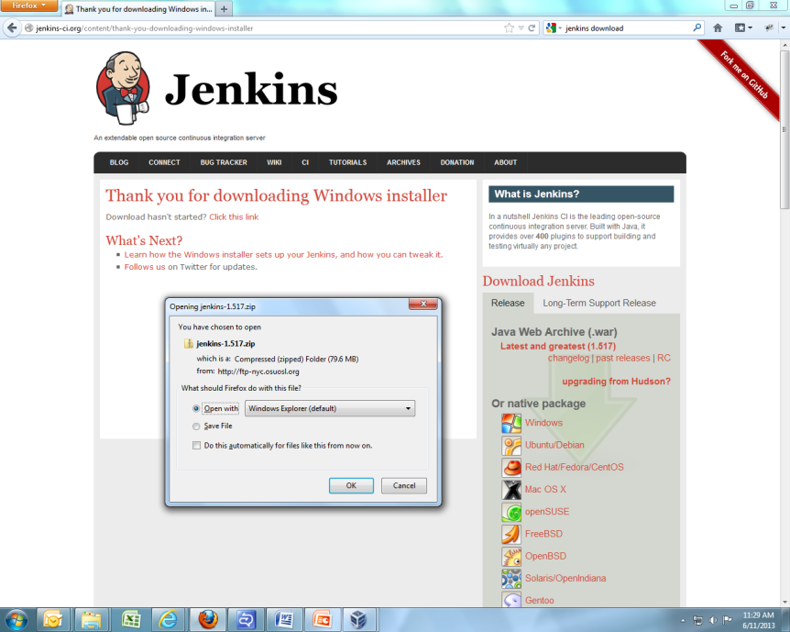
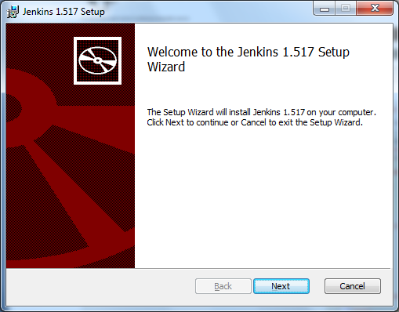
Download Jenkins as shown in next picture
for windows machine.
Follow instructions as per wizard to complete the set up.

Slide 2
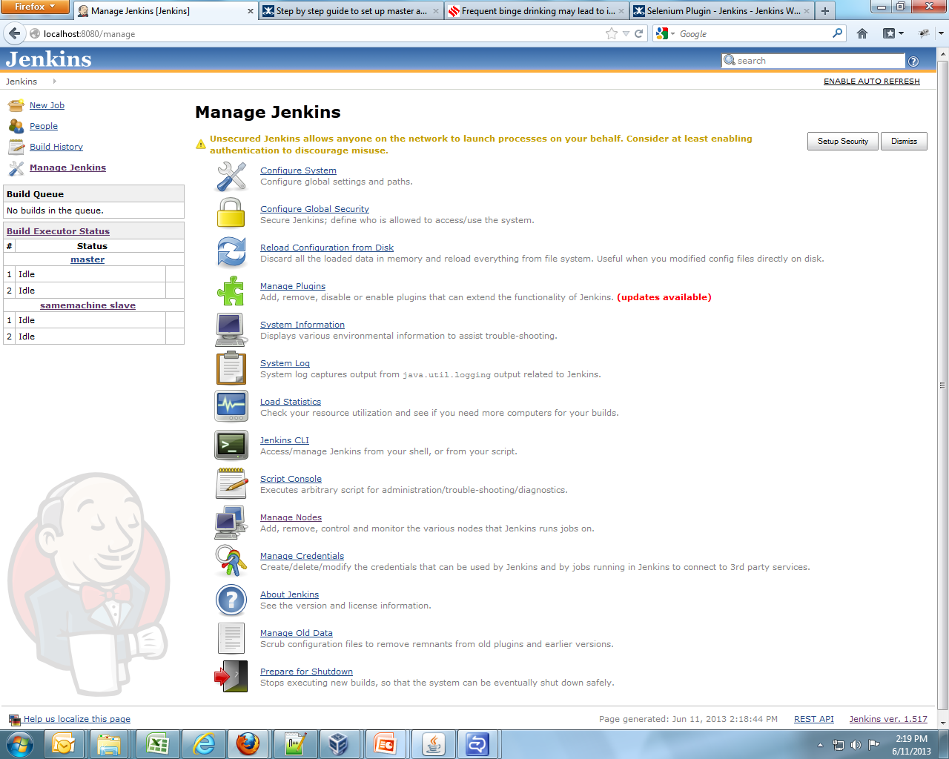
After completing set up from from wizard
do check that jenkins is running up
at
localhost:8080
We need to have jre6 and latest versio of jdk installed to set up master and slave machine within Jenkins.

Slide 3
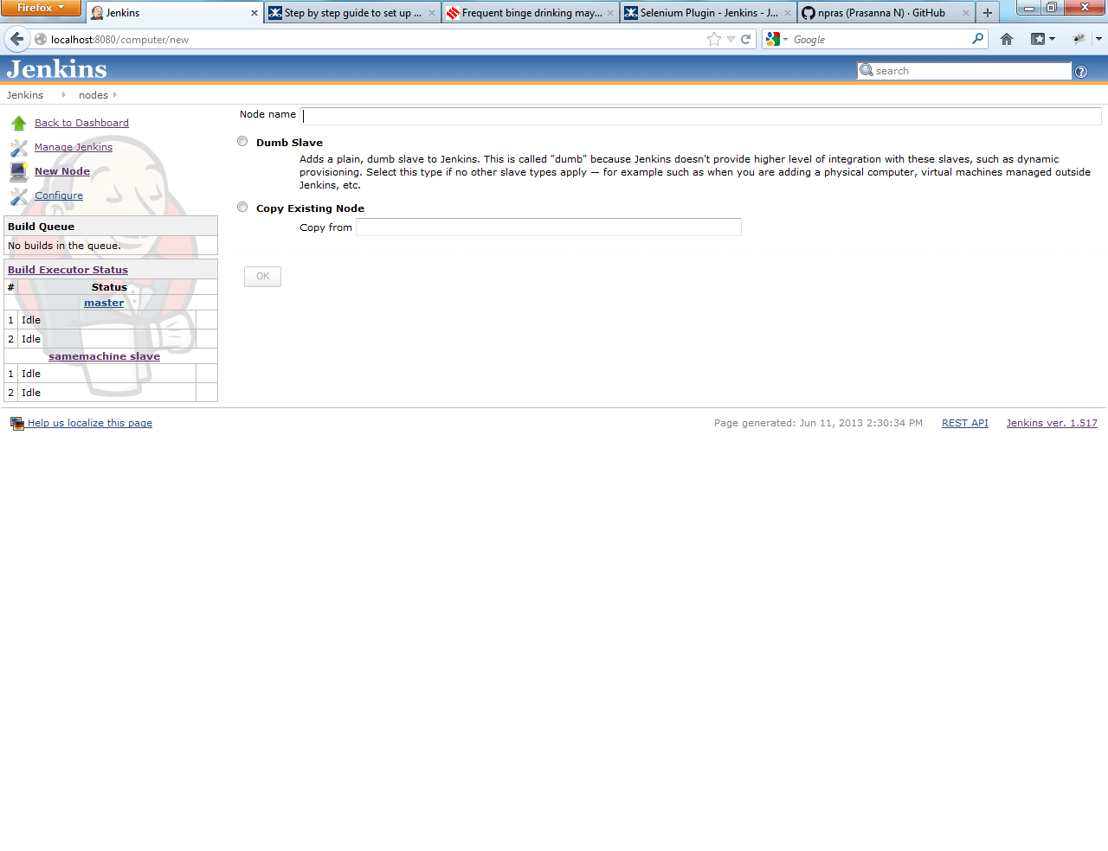
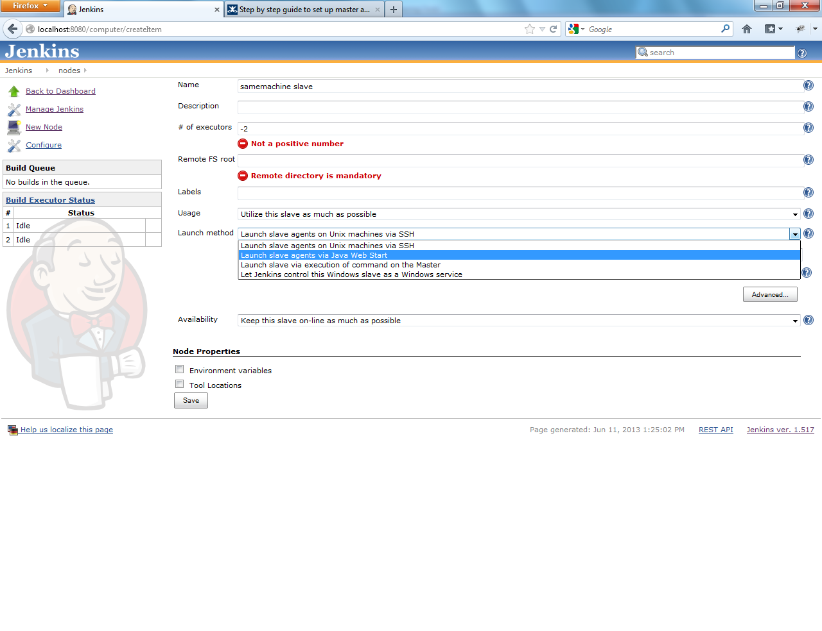
Go to “Manage jenkins”
Click on “Manage Nodes“
Add a Dumb slave node as shown in figure.
Click on “OK”
Enter no of executors as “-2”
Enter Remote FS root as direcotry of your choice in machine where you want to execute selenium test.
Launch method should be selected as
“Launch slave agent via Java Web Start”
Click on “Save”

Slide 4
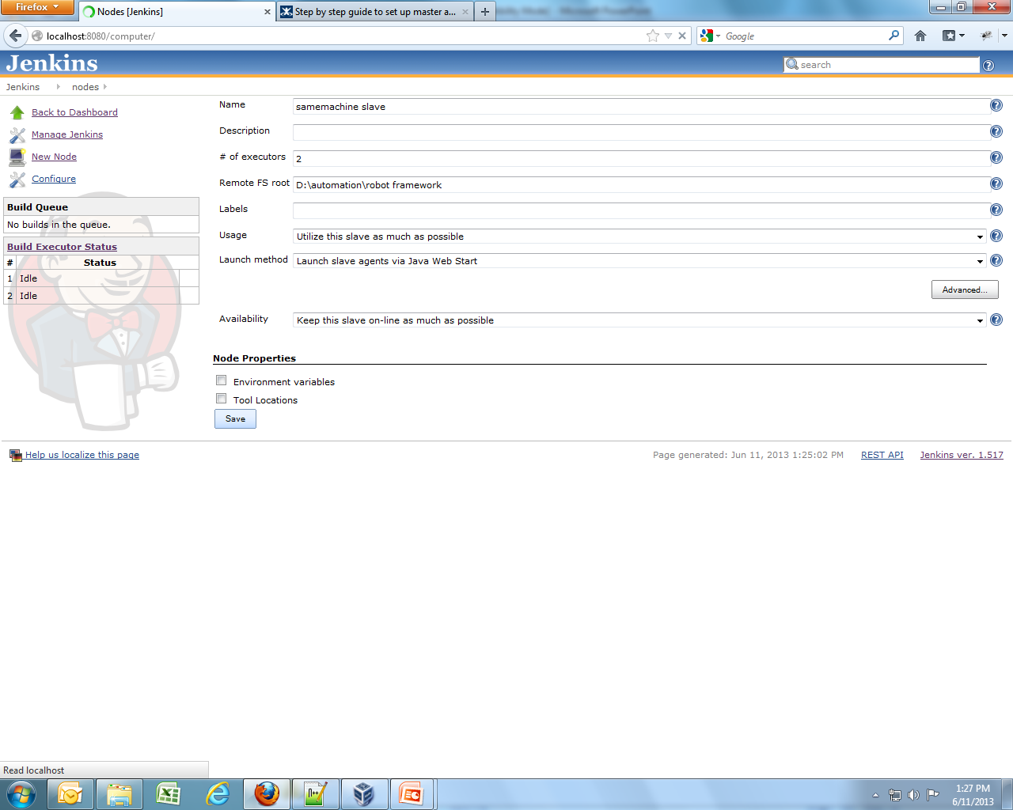
Also enter other parameters like
availability “Keep this slave on-line as much as possible”

Slide 5
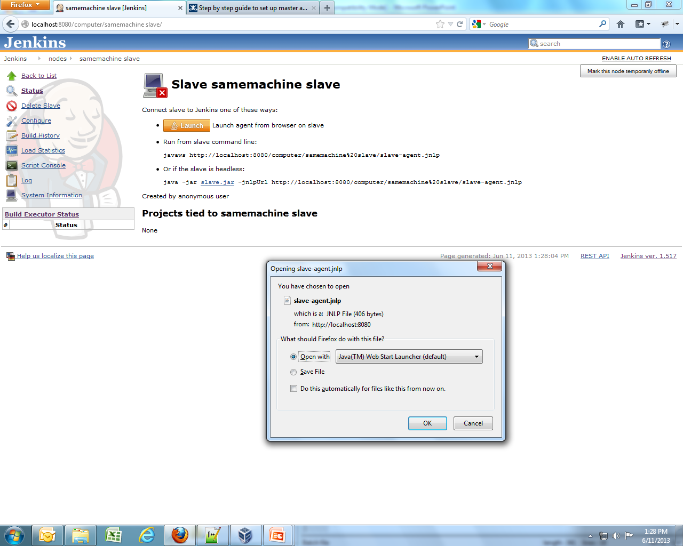
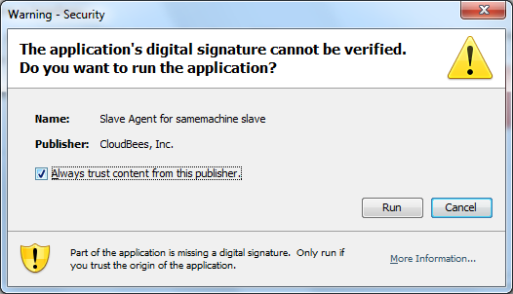

Slide 6
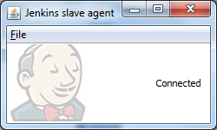
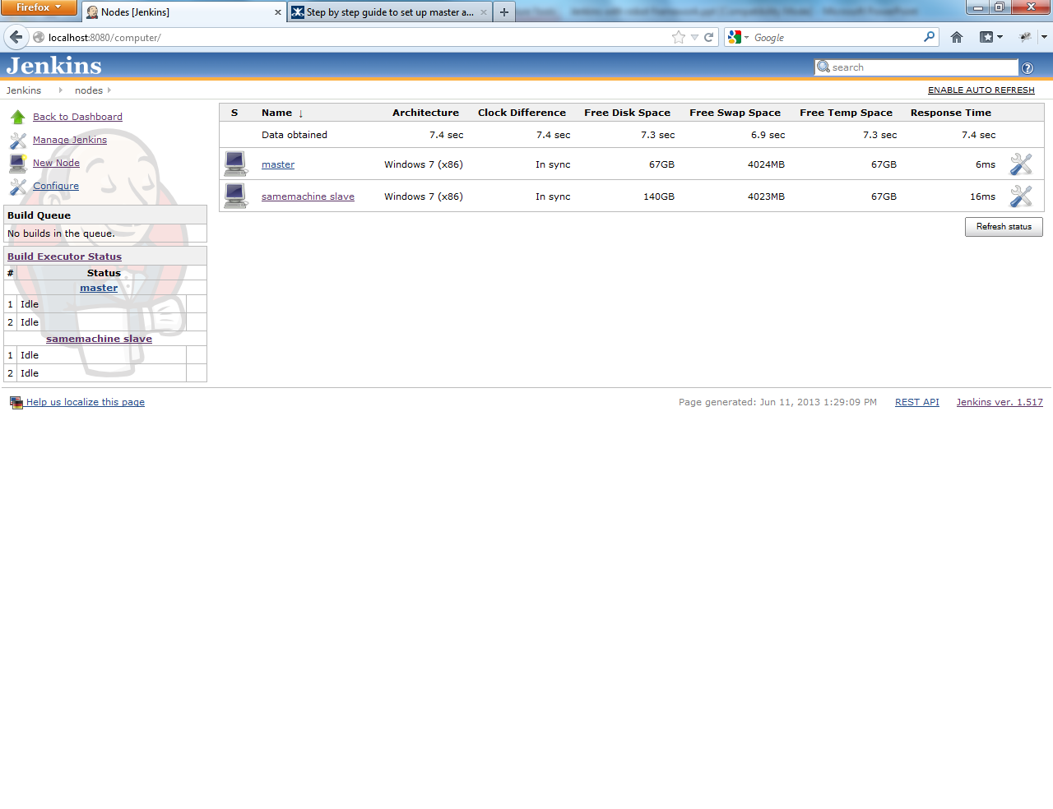

Slide 7
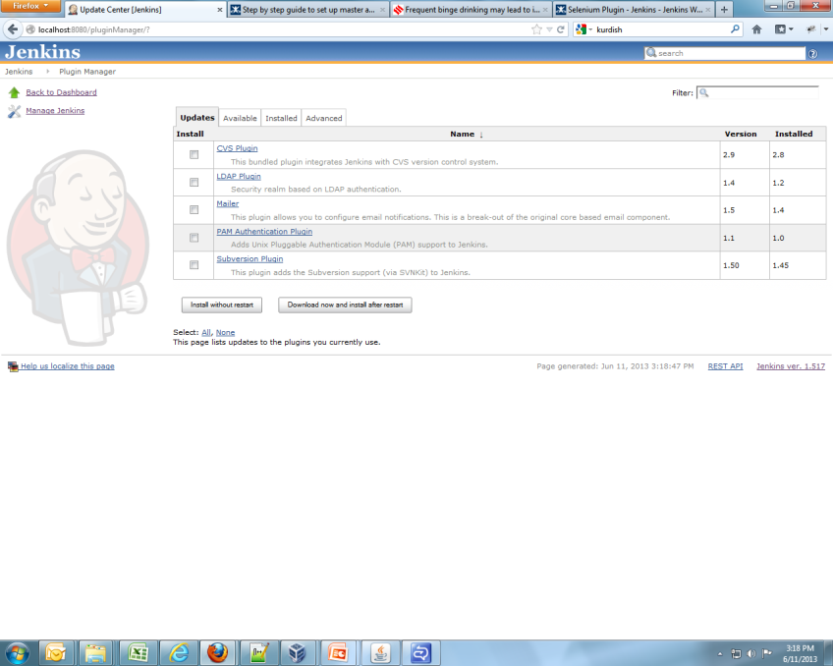
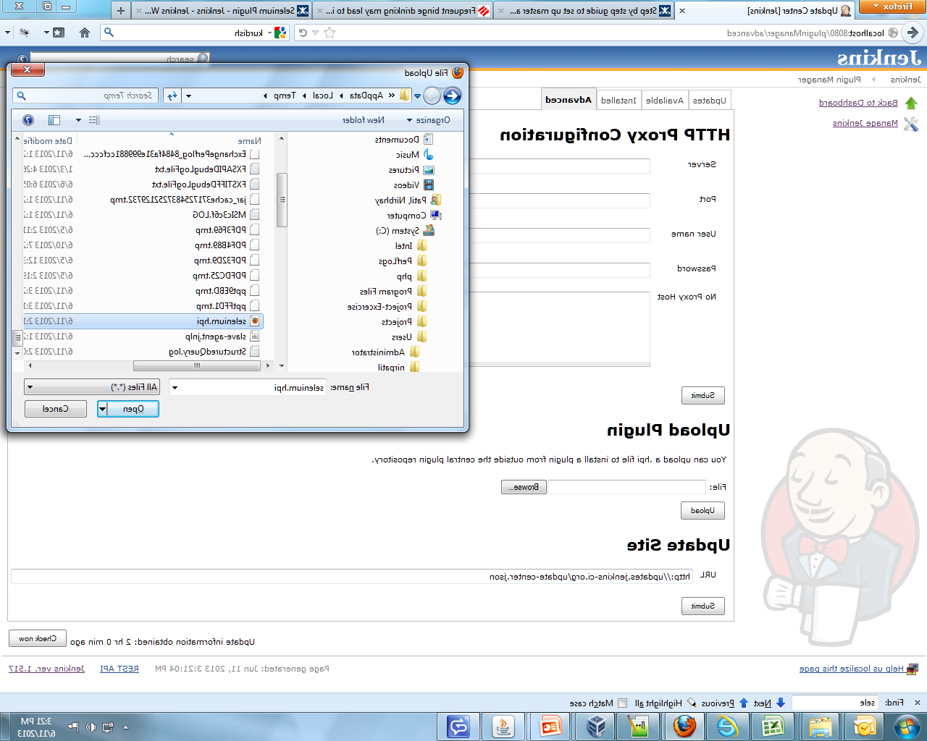

Slide 8
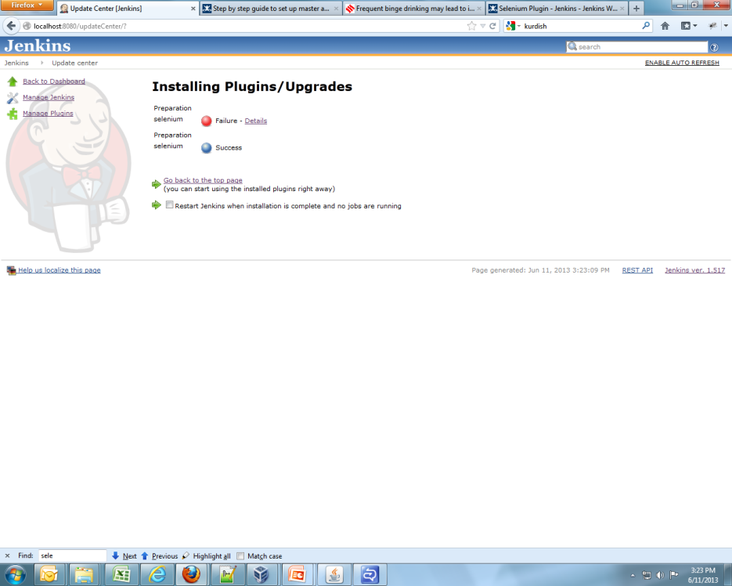
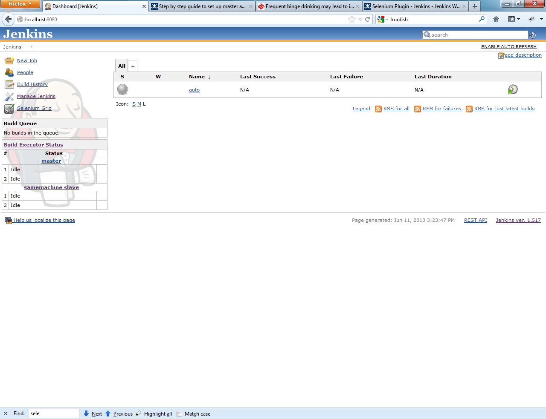

Slide 9
